Slide 1
Flight Booking Prediction Model Summary

Slide 2
Summary
• Model: Random Forest Classifier (GridSearchCV tuned)
• Cross-validated F1 Score: 0.560
• Top Features: length_of_stay, route, purchase_lead, booking_origin
• Insights:
- Length of stay and route are the most influential predictors.
- Model shows good generalisation (see F1 score).
- Balanced dataset improves prediction for all trip types.
• See right for feature importance visualisation.

Slide 3
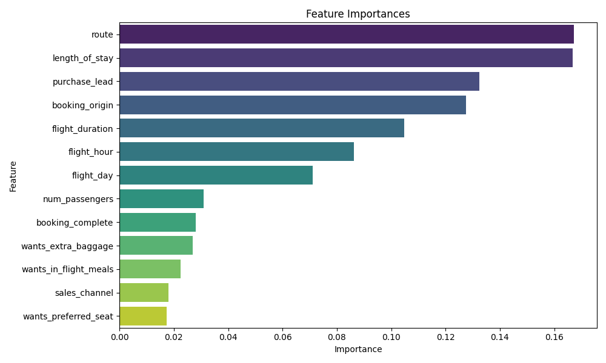

Slide 4
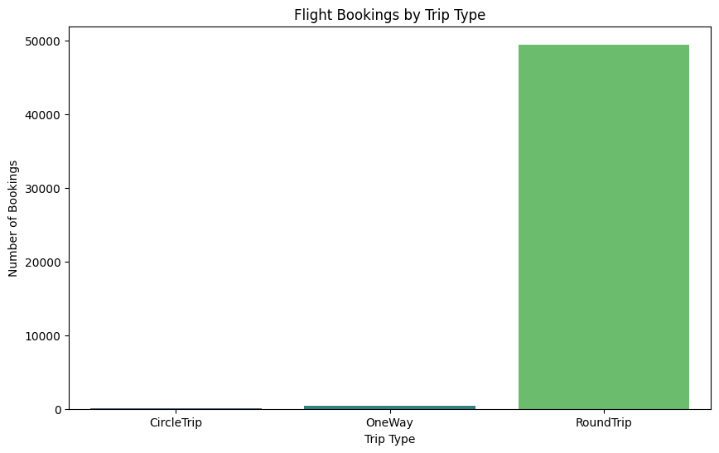

Slide 5
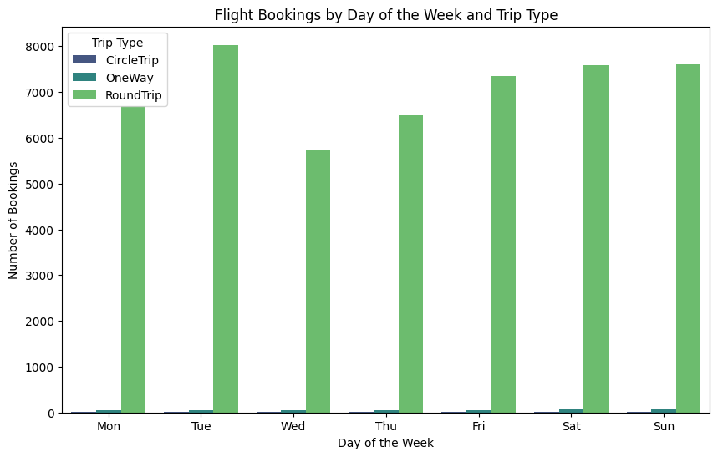

Slide 6
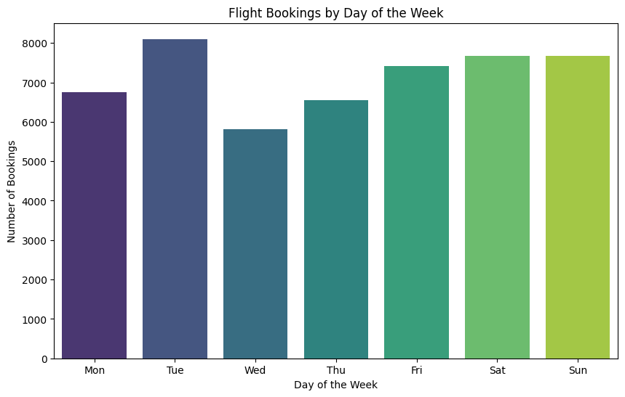

Slide 7
Overall Result
Best Parameters Found: {'class_weight': 'balanced', 'max_depth': 10, 'min_samples_leaf': 2, 'min_samples_split': 5, 'n_estimators': 200}
Classification Report:
precision recall f1-score support
0 0.08 0.04 0.06 23
1 0.66 0.59 0.62 78
2 0.81 0.88 0.84 201
accuracy 0.74 302
macro avg 0.51 0.50 0.51 302
weighted avg 0.71 0.74 0.73 302
Confusion Matrix:
[[ 1 7 15]
[ 5 46 27]
[ 7 17 177]]
Predicted Trip Type: 2

Slide 8
THANK YOU

